Slide 1

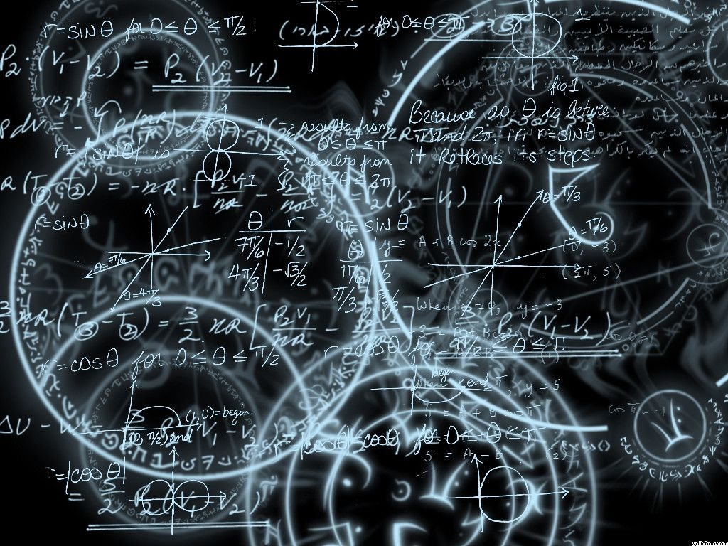
Azərbaycan Dövlət Neft və Sənaye Universiteti
Calculus
Single Variable

Slide 2
Integration Techniques:
Integration by Parts

Slide 3
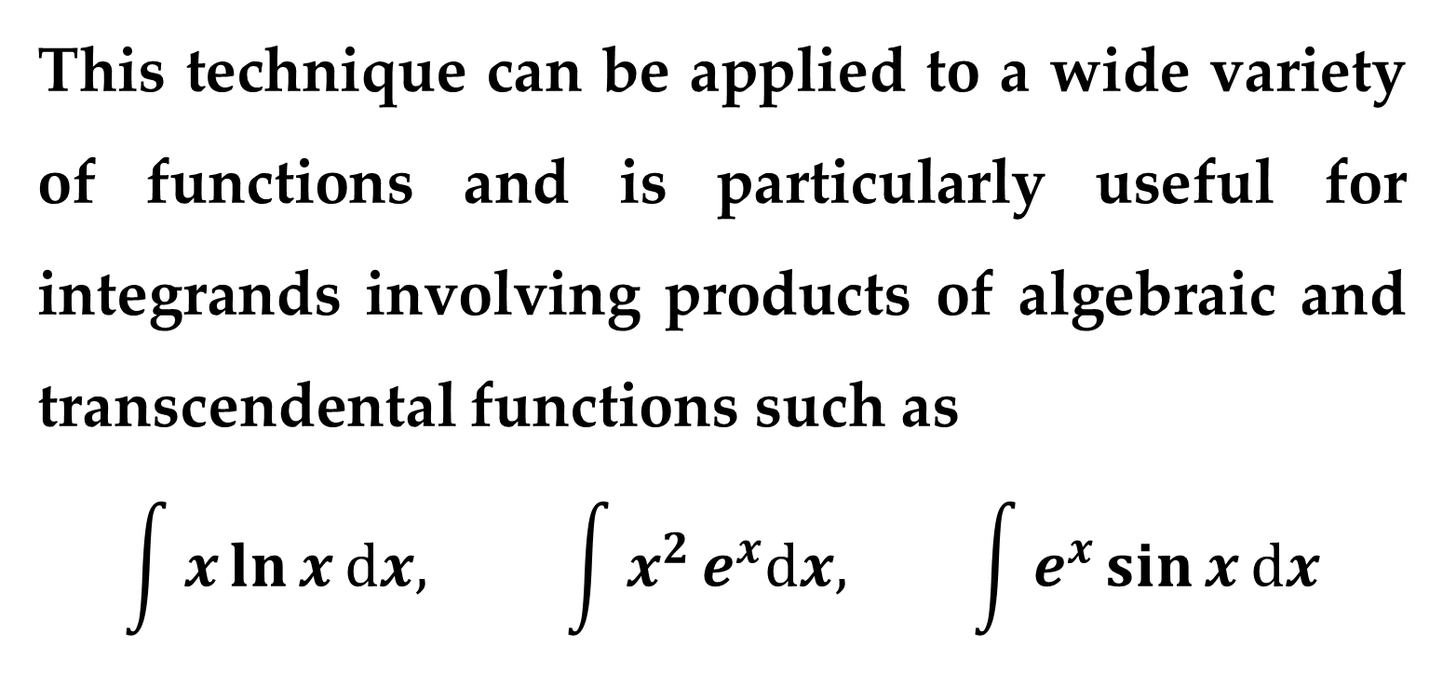
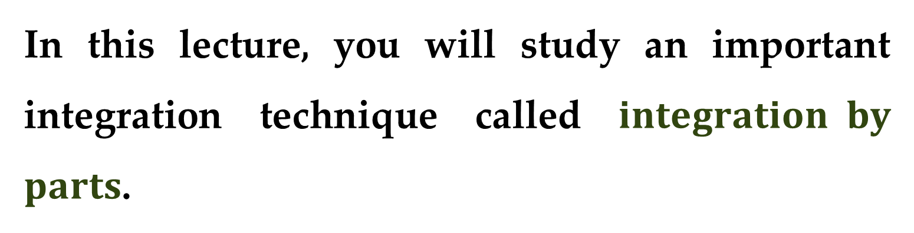
In this lecture, you will study an important integration technique called $integration by$ $parts$.
This technique can be applied to a wide variety of functions and is particularly useful for integrands involving products of algebraic and transcendental functions such as
$$\int{x}\ln{x}dx, \int{x^{2}}e^{x}dx, \int{e^{x}}\sin{x}dx$$

Slide 4
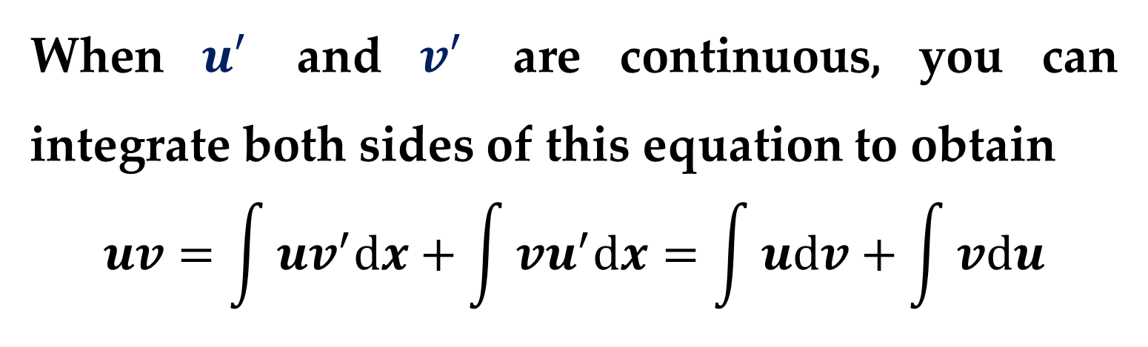
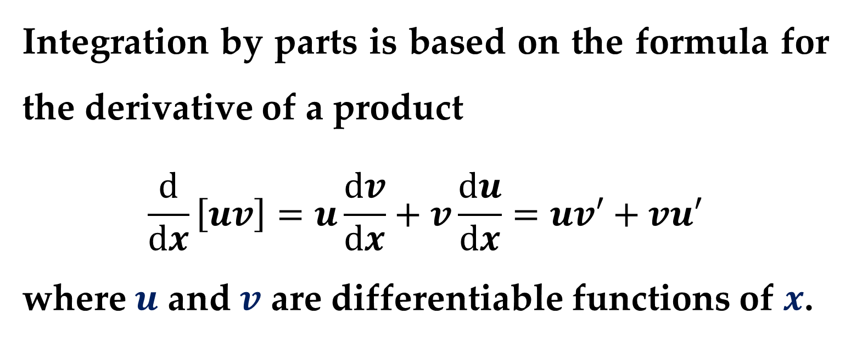
Integration by parts is based on the formula for the derivative of a product
$$\frac{d}{dx}\left[uv\right]=u\frac{dv}{dx}+v\frac{du}{dx}=uv′+vu′$$
where $u$ and $v$ are differentiable functions of $x$.
When $u′$ and $v′$ are continuous, you can integrate both sides of this equation to obtain
$$uv=\int{uv^{′}dx}+\int{vu^{′}dx}=\int{udv}+\int{vdu}$$

Slide 5
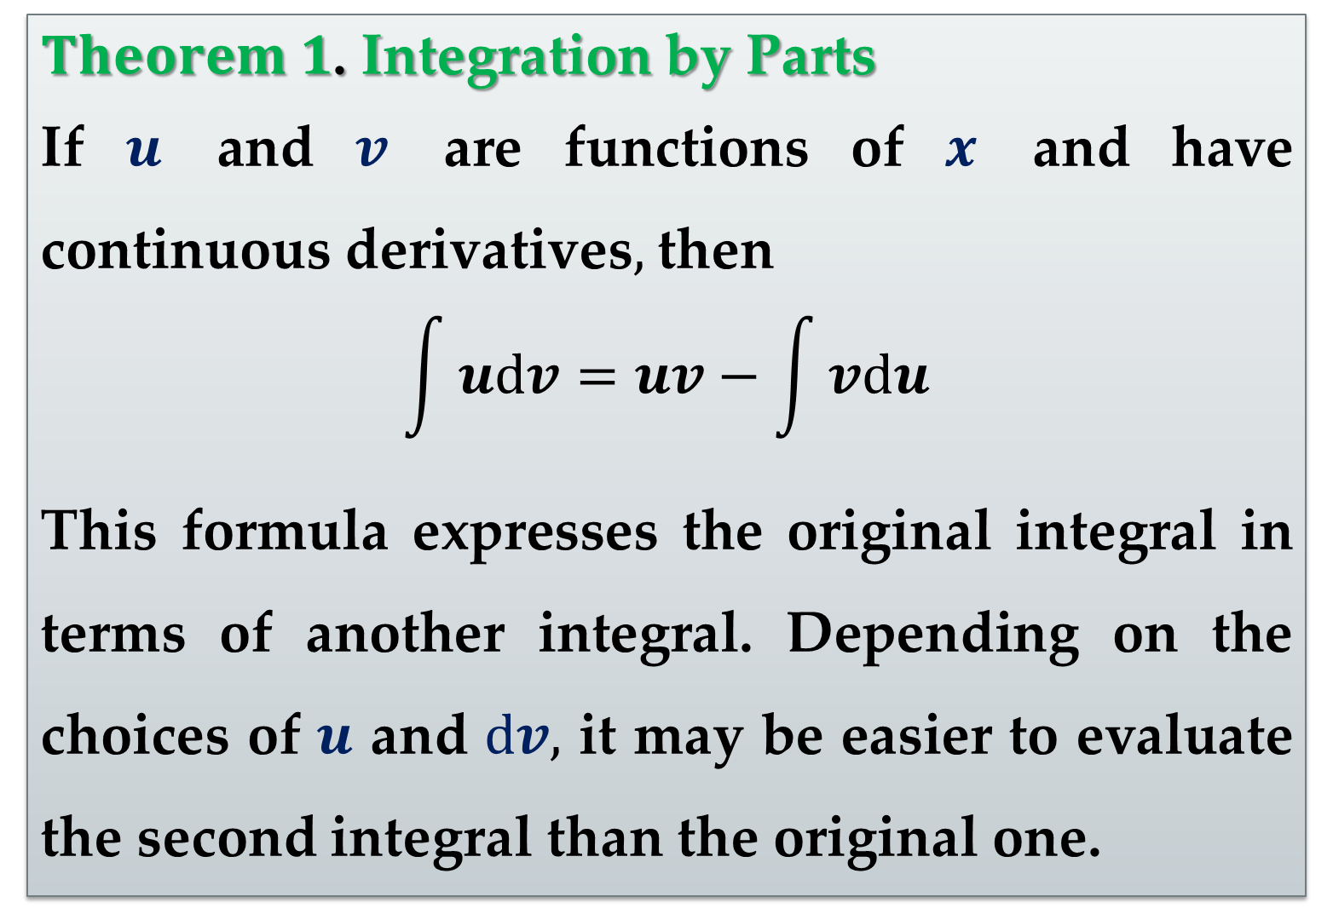
$Theorem 1$. Integration by Parts
If $u$ and $v$ are functions of $x$ and have continuous derivatives$,$ then
$$\int{udv}=uv−\int{vdu}$$
This formula expresses the original integral in terms of another integral. Depending on the choices of $u$ and $dv,$ it may be easier to evaluate the second integral than the original one.

Slide 6
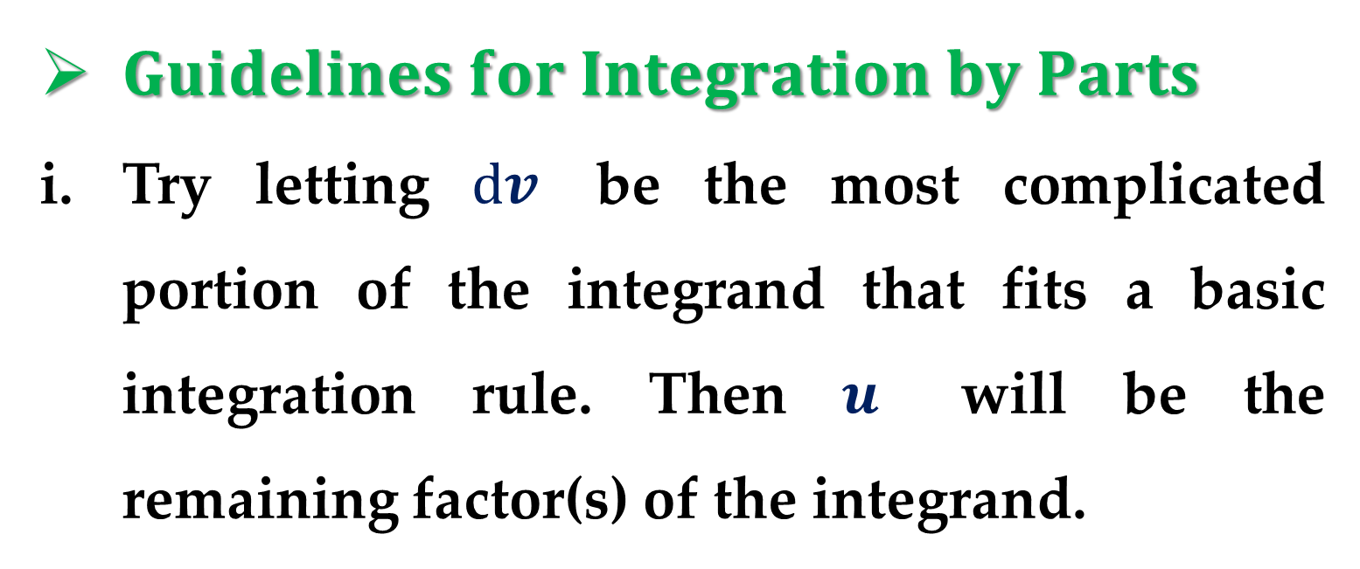
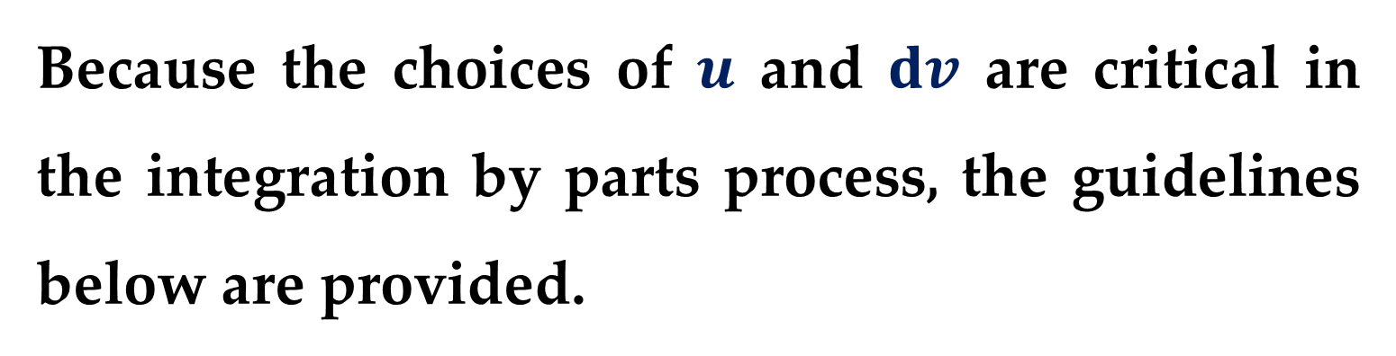
Because the choices of $u$ and $dv$ are critical in the integration by parts process, the guidelines below are provided.
$Guidelines for Integration by Parts$
Try letting $dv$ be the most complicated portion of the integrand that fits a basic integration rule. Then $u$ will be the remaining factor(s) of the integrand.

Slide 7
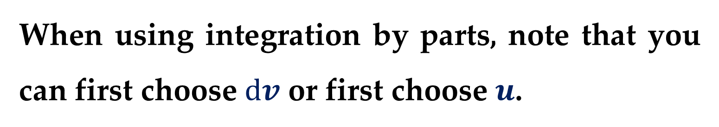
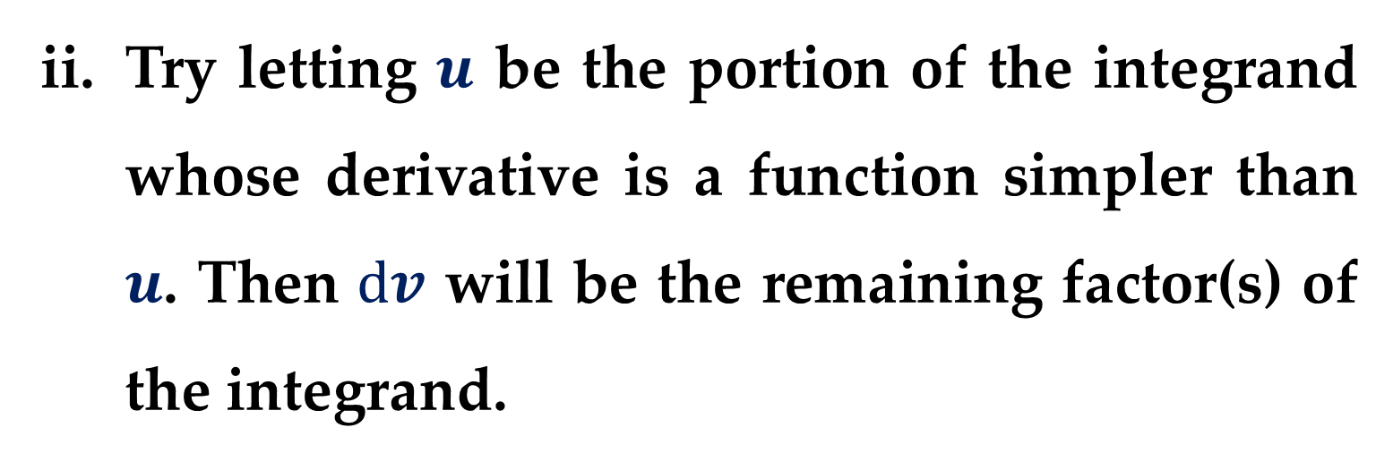
Try letting $u$ be the portion of the integrand whose derivative is a function simpler than $u$. Then $dv$ will be the remaining factor(s) of the integrand.
When using integration by parts, note that you can first choose $dv$ or first choose $u$.
After you choose, however, the choice of the other factor is determined — it must be the remaining portion of the integrand.

Slide 8
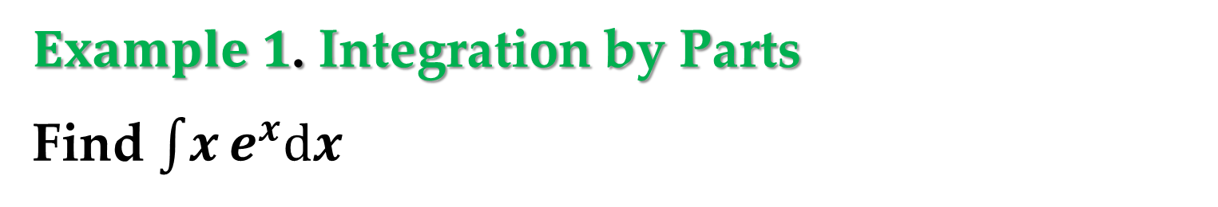
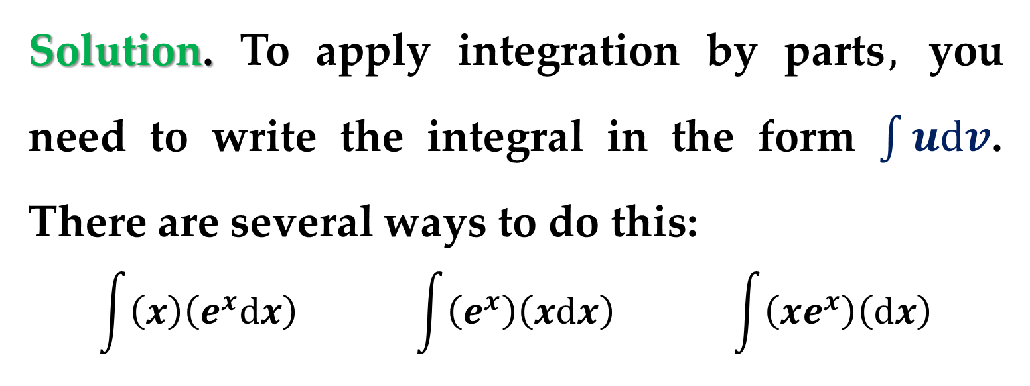
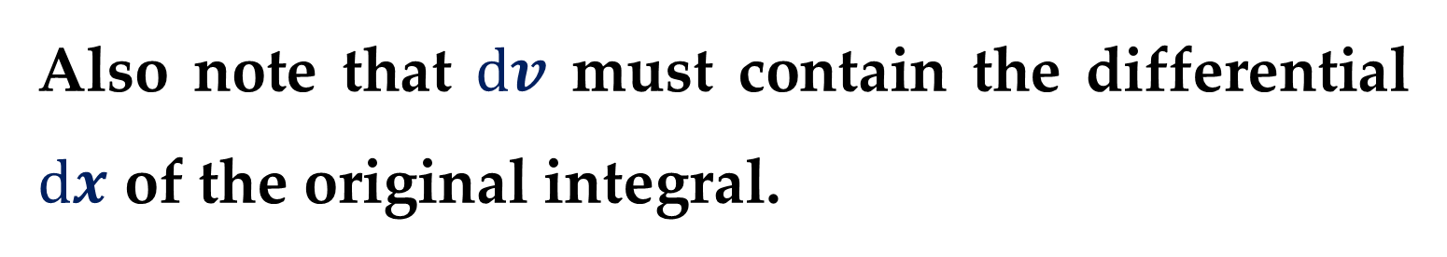
Also note that $dv$ must contain the differential $dx$ of the original integral.
$Example 1$. Integration by Parts
Find $\int{x}e^{x}dx$
Solution. To apply integration by parts$,$ you need to write the integral in the form $\int{udv}$. There are several ways to do this:
$$\int{\left(x\right)\left(e^{x}dx\right)} \int{\left(e^{x}\right)\left(xdx\right)} \int{\left(xe^{x}\right)\left(dx\right)}$$

Slide 9
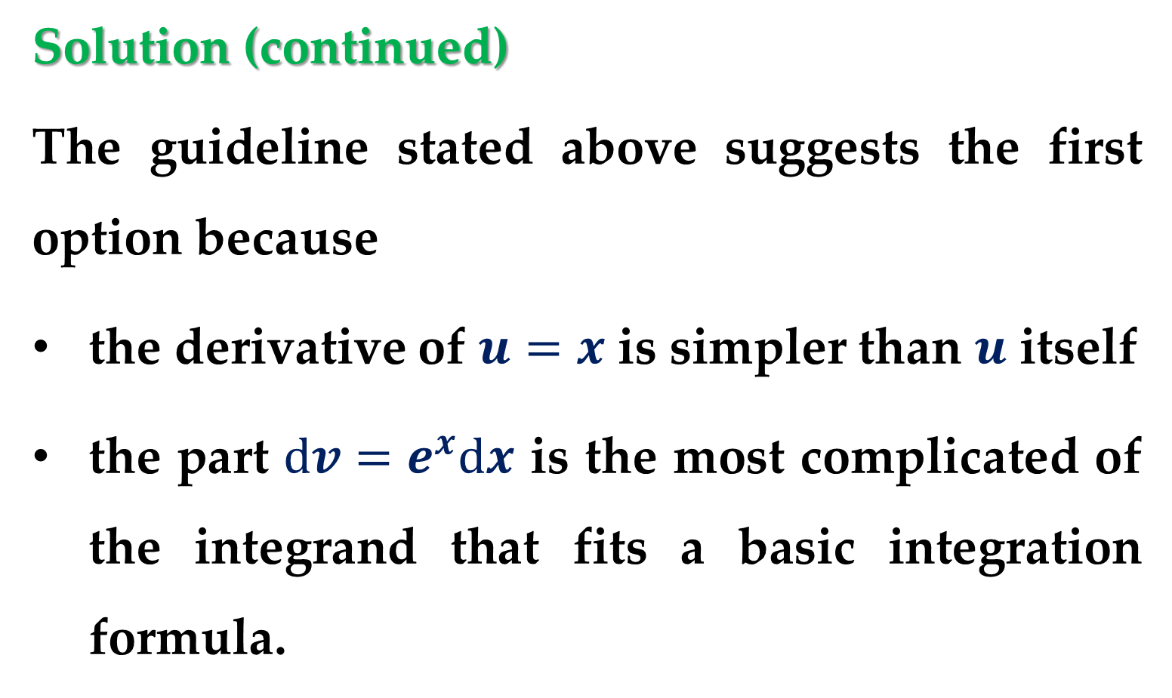
Solution (continued)
The guideline stated above suggests the first option because
the derivative of $u=x$ is simpler than $u$ itself
the part $dv=e^{x}dx$ is the most complicated of the integrand that fits a basic integration formula.

Slide 10
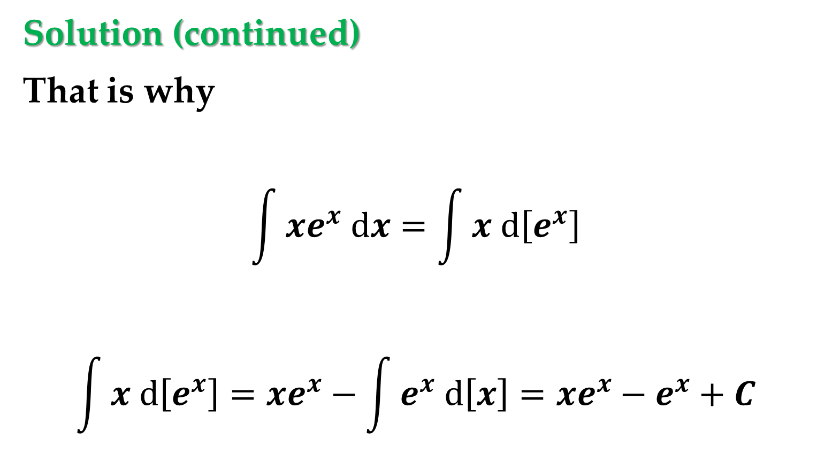
Solution (continued)
That is why
$$\int{xe^{x} dx}=\int{x d\left[e^{x}\right]}$$
$$\int{x d\left[e^{x}\right]}=xe^{x}−\int{e^{x} d\left[x\right]}=xe^{x}−e^{x}+C$$

Slide 11
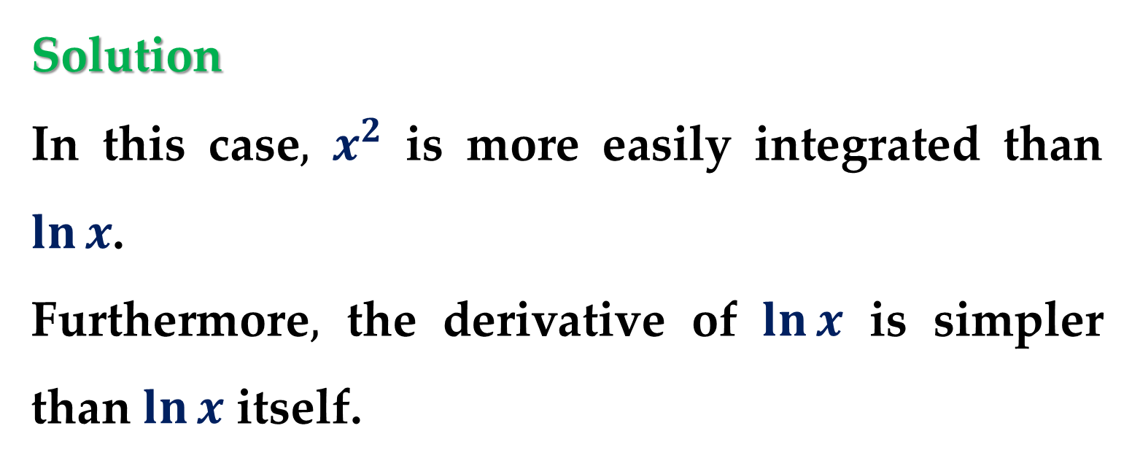
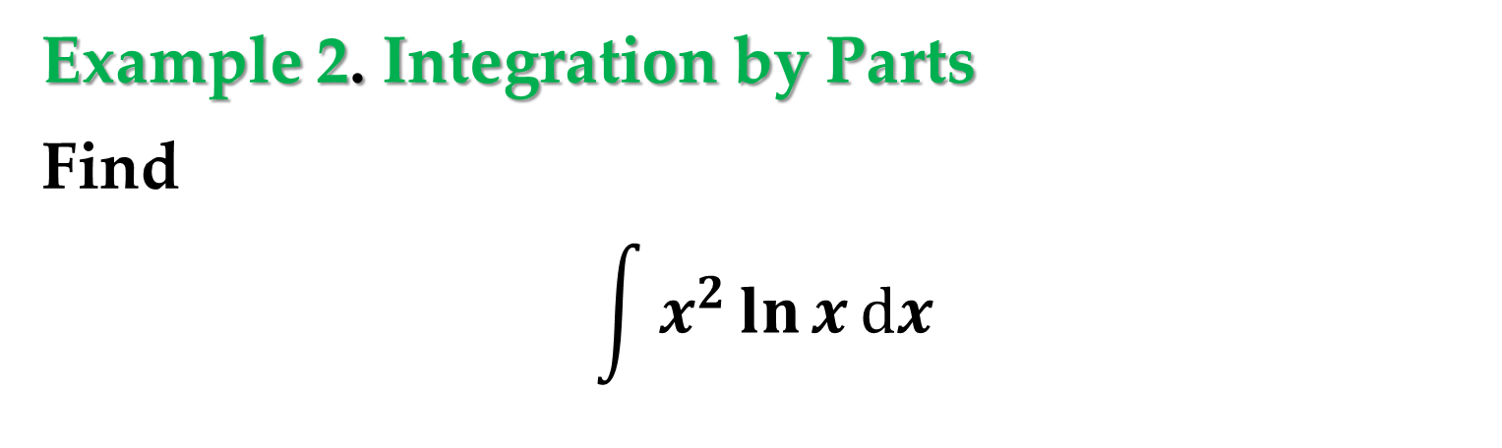
Example 2. Integration by Parts
Find
$$\int{x^{2}}\ln{x}dx$$
Solution
In this case$,$ $x^{2}$ is more easily integrated than $\ln{x}$.
Furthermore$,$ the derivative of $\ln{x}$ is simpler than $\ln{x}$ itself.

Slide 12

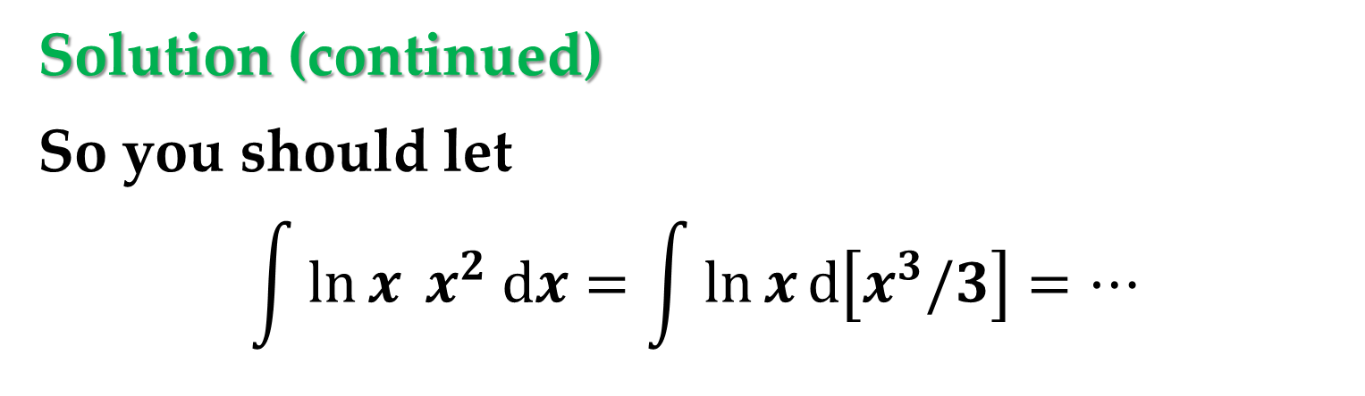
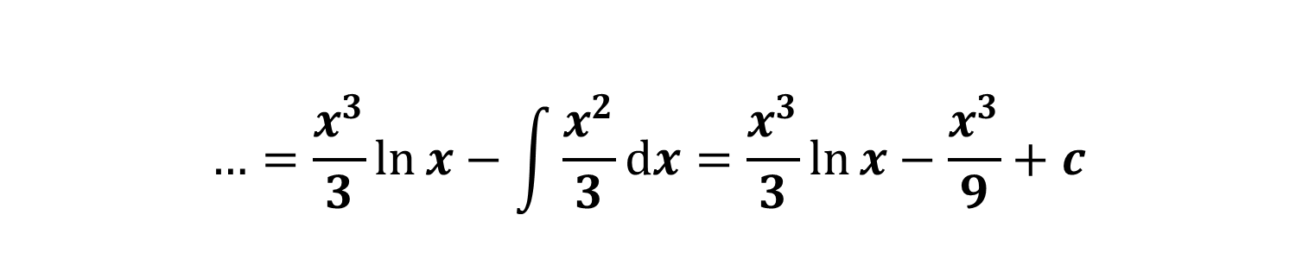
Solution (continued)
So you should let
$$\int{\ln{x} x^{2} dx}=\int{\ln{x}d\left[x^{3}/3\right]}=…$$
$$…=\frac{x^{3}}{3}\ln{x}−\int{\frac{x^{3}}{3}d\left[\ln{x}\right]}=…$$
$$…=\frac{x^{3}}{3}\ln{x}−\int{\frac{x^{2}}{3}dx}=\frac{x^{3}}{3}\ln{x}−\frac{x^{3}}{9}+c$$

Slide 13
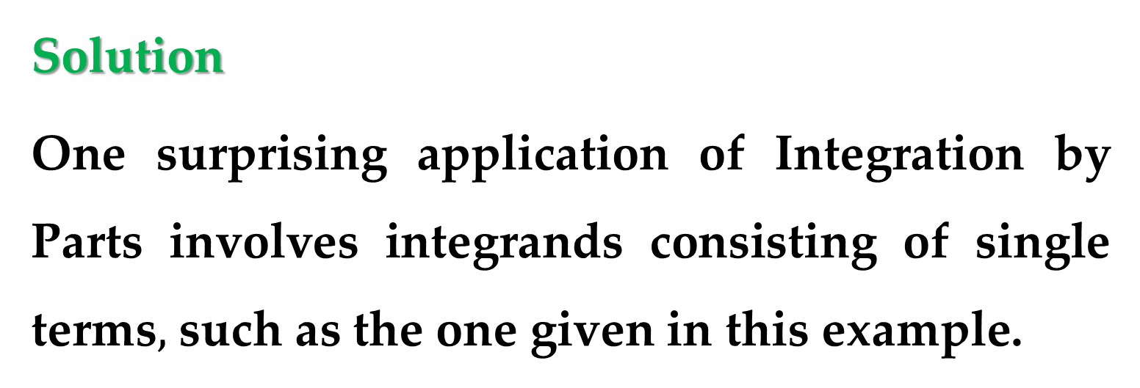
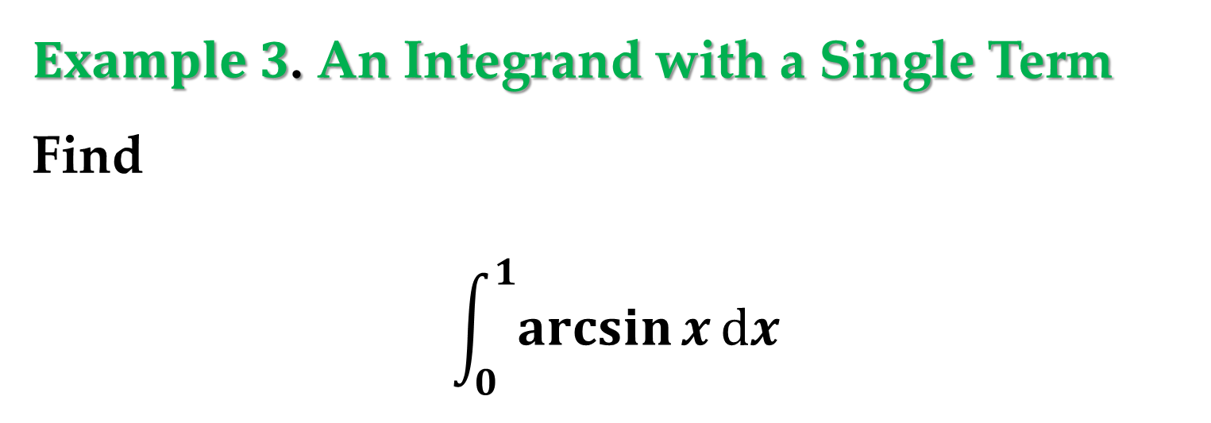
$Example 3$. An Integrand with a Single Term
Find
$$\int_{0}^{1}{\arcsin{x}}dx$$
Solution
One surprising application of Integration by Parts involves integrands consisting of single terms$,$ such as the one given in this example.

Slide 14
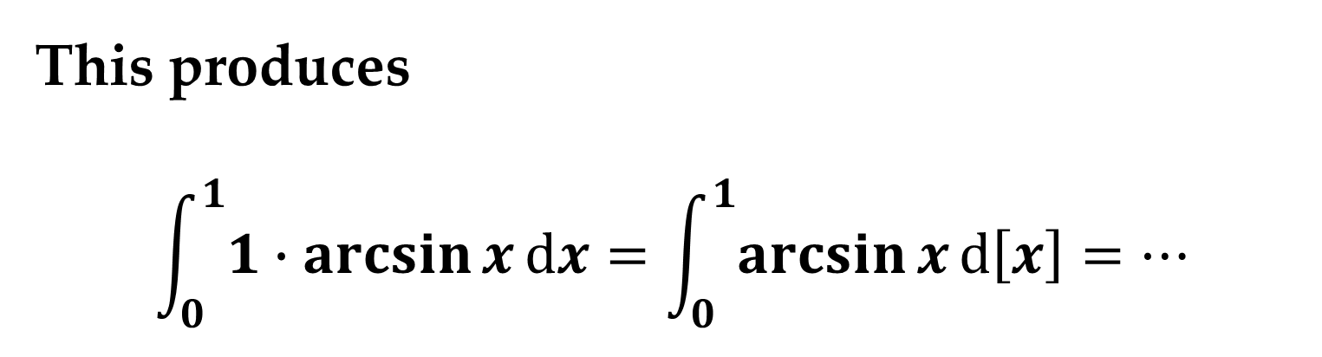
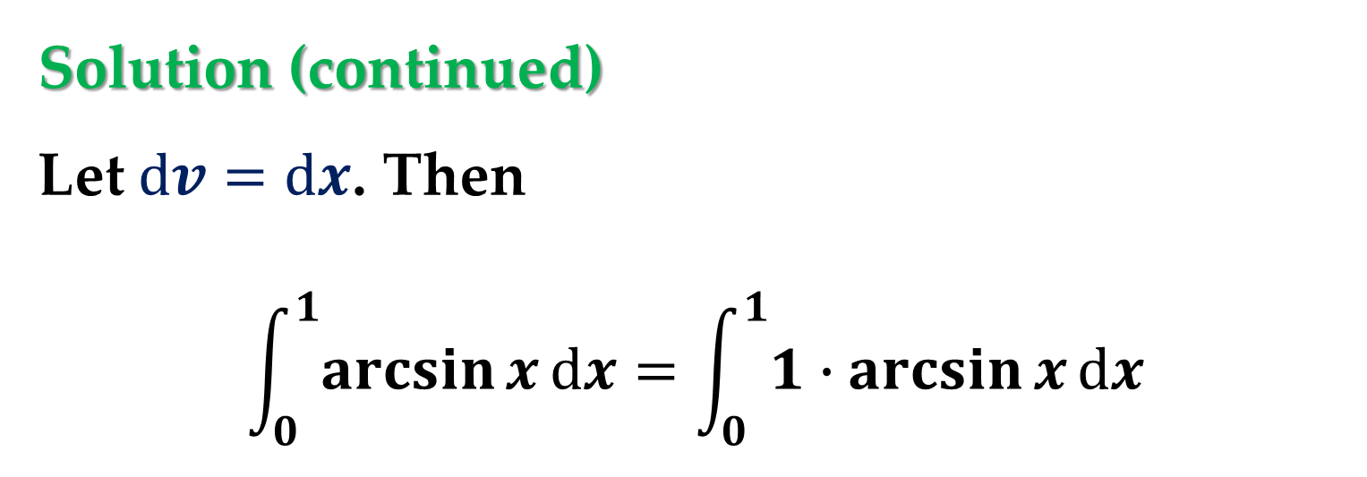
Solution (continued)
Let $dv=dx$. Then
$$\int_{0}^{1}{\arcsin{x}}dx=\int_{0}^{1}{1∙\arcsin{x}}dx$$
This produces
$$\int_{0}^{1}{1∙\arcsin{x}}dx=\int_{0}^{1}{\arcsin{x}}d\left[x\right]=…$$

Slide 15
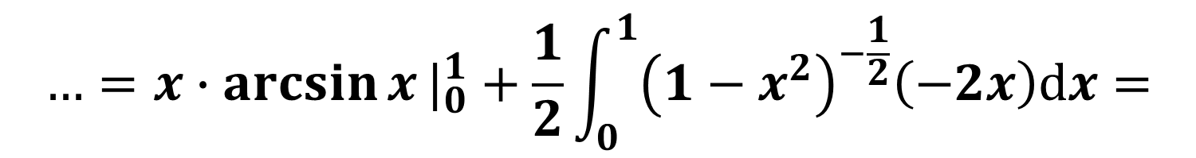
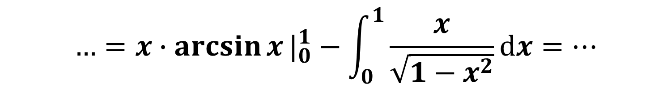
Solution (continued)
$$…=x∙\arcsin{x}|_{0}^{1}−\int_{0}^{1}{\frac{x}{\sqrt{1−x^{2}}}dx}=…$$
$$…=x∙\arcsin{x}|_{0}^{1}+\frac{1}{2}\int_{0}^{1}{{\left(1−x^{2}\right)}^{−\frac{1}{2}}\left(−2x\right)dx}=$$
$$…=x∙\arcsin{x}|_{0}^{1}+\sqrt{1−x^{2}}|_{0}^{1}$$

Slide 16
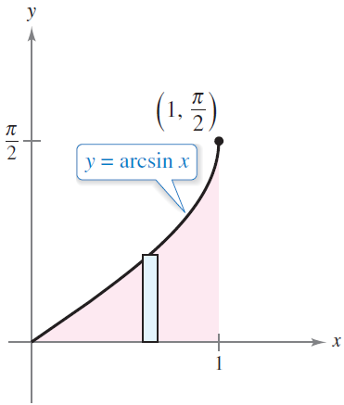
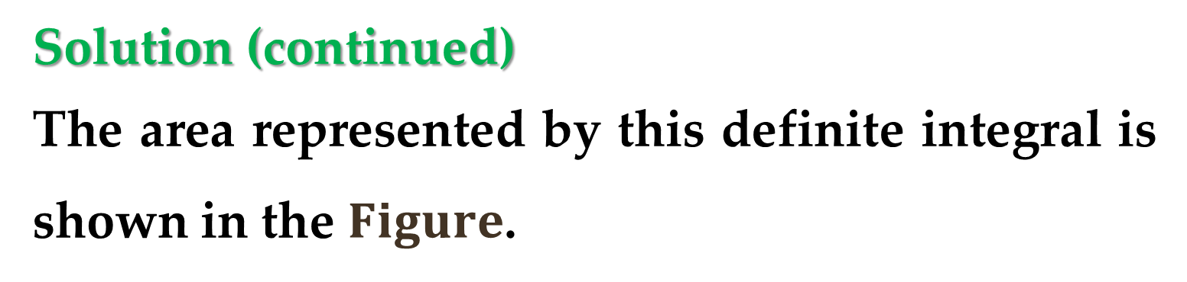
Solution (continued)
The area represented by this definite integral is shown in the $Figure$.

Slide 17
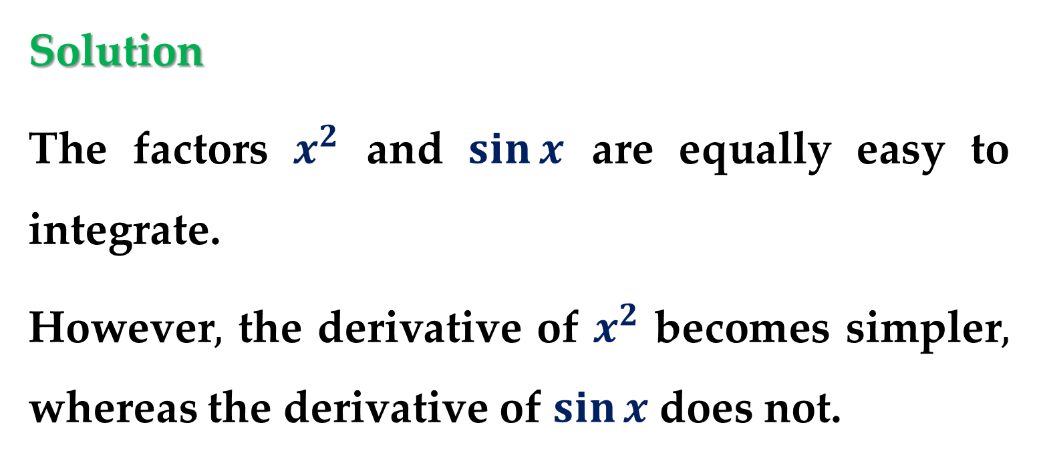
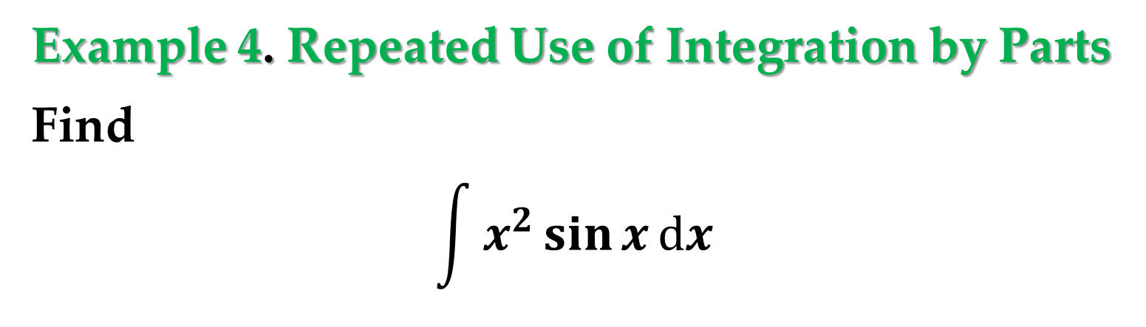
Example 4. Repeated Use of Integration by Parts
Find
$$\int{x^{2}\sin{x}}dx$$
Solution
The factors $x^{2}$ and $\sin{x}$ are equally easy to integrate.
However$,$ the derivative of $x^{2}$ becomes simpler$,$ whereas the derivative of $\sin{x}$does not.

Slide 18
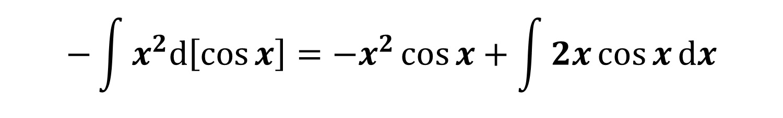
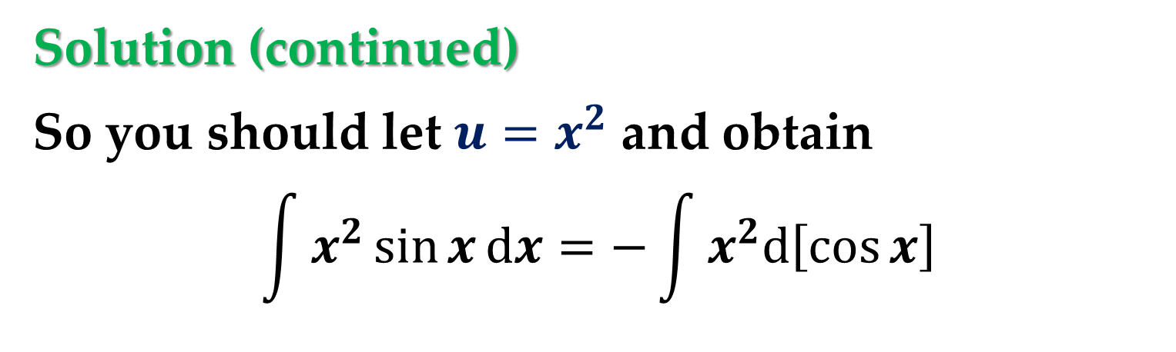
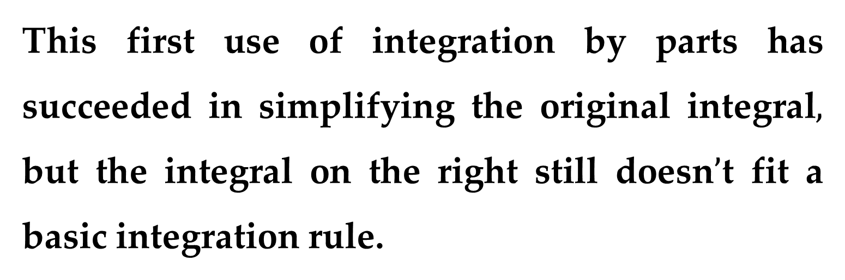
Solution (continued)
So you should let ${u=x}^{2}$ and obtain
$$\int{x^{2}\sin{x}}dx=−\int{x^{2}d\left[\cos{x}\right]}$$
$$−\int{x^{2}d\left[\cos{x}\right]}=−x^{2}\cos{x}+\int{2x\cos{x}dx}$$
This first use of integration by parts has succeeded in simplifying the original integral$,$ but the integral on the right still doesn$’$t fit a basic integration rule.

Slide 19
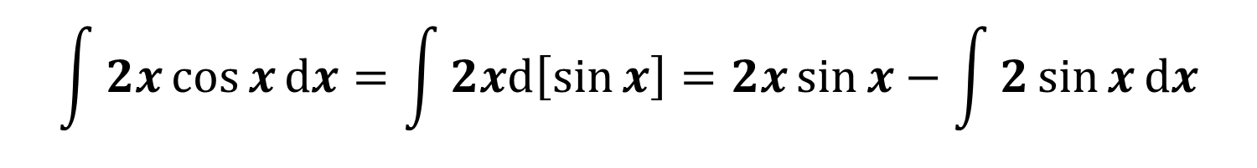
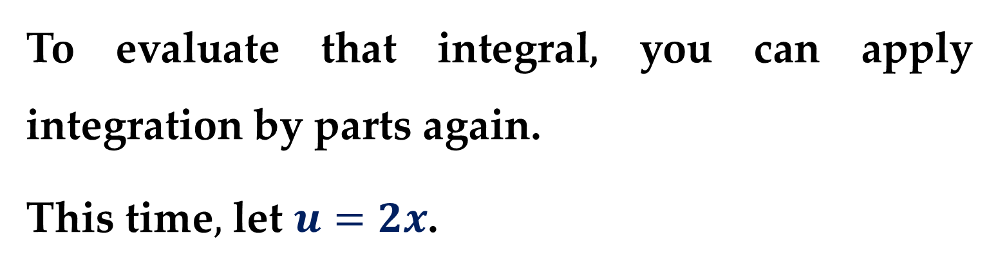
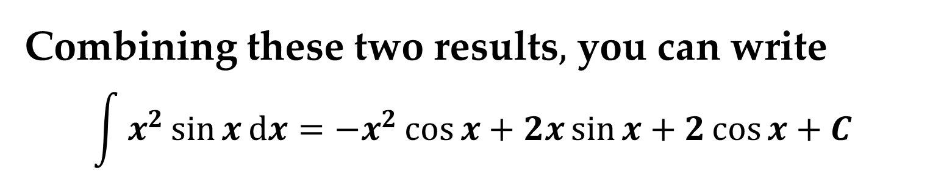
Solution (continued)
To evaluate that integral, you can apply integration by parts again.
This time$,$ let $u=2x$.
$$\int{2x\cos{x}dx}=\int{2xd\left[\sin{x}\right]}=2x\sin{x}−\int{2\sin{x}dx}$$
Combining these two results$,$ you can write
$$\int{x^{2}\sin{x}}dx=−x^{2}\cos{x}+2x\sin{x}+2\cos{x}+C$$

Slide 20
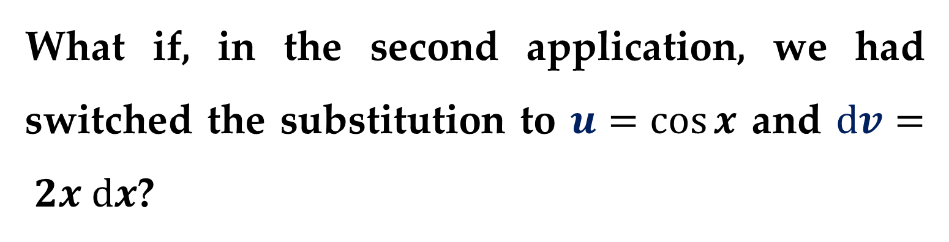
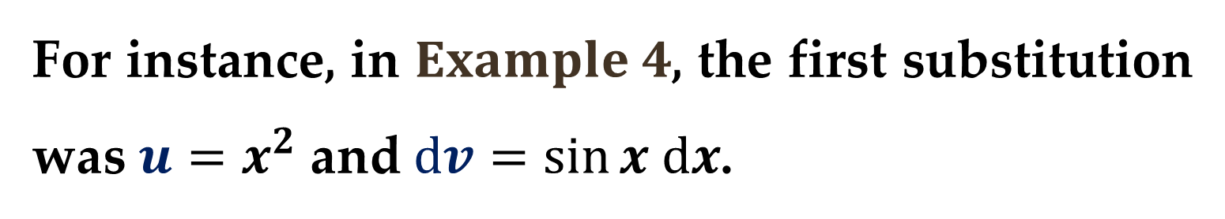
When making repeated applications of integration by parts, you need to be careful not to interchange the substitutions in successive applications.
For instance, in $Example 4$, the first substitution was $u=x^{2}$ and $dv=sin⁡x dx$.
What if, in the second application, we had switched the substitution to $u=cos⁡x$ and $dv= 2x dx$?

Slide 21
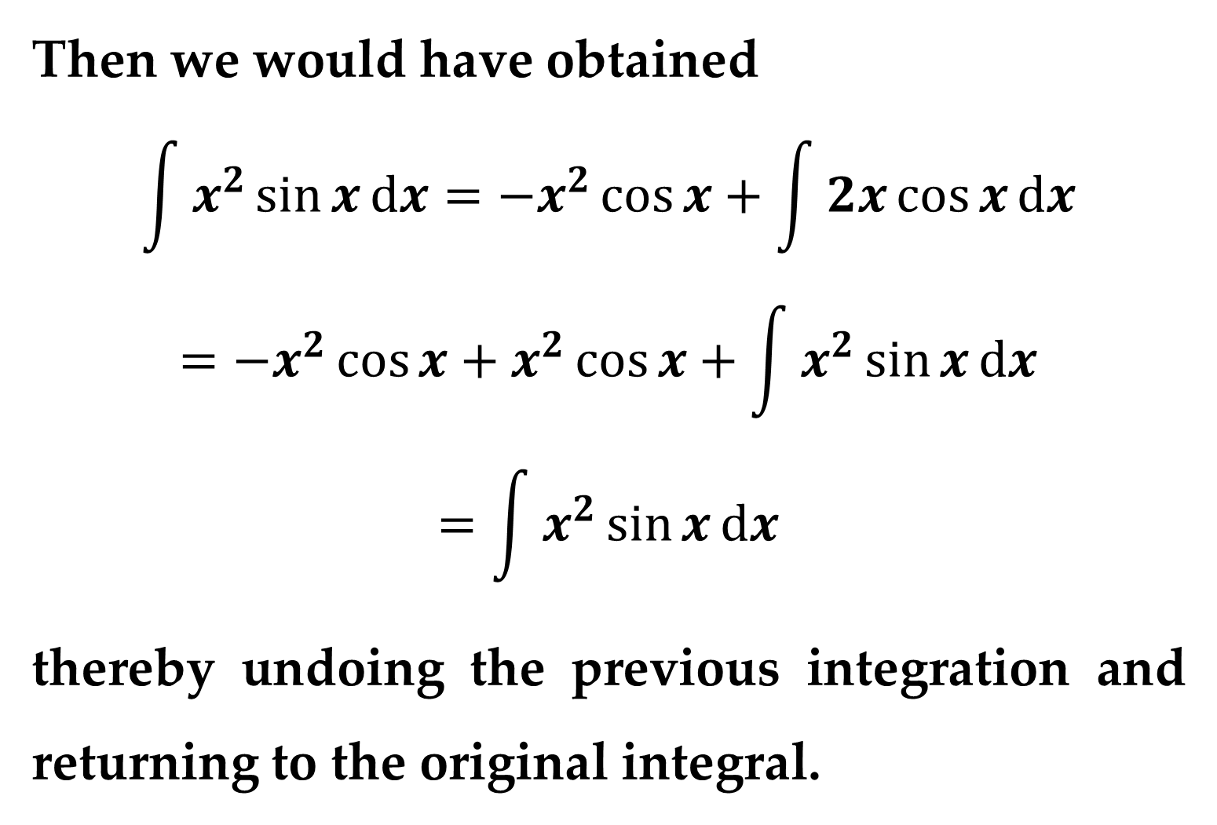
Then we would have obtained
$$\int{x^{2}\sin{x}dx}=−x^{2}\cos{x}+\int{2x\cos{x}dx}$$
$$=−x^{2}\cos{x}+x^{2}\cos{x}+\int{x^{2}\sin{x}dx}$$
$$=\int{x^{2}\sin{x}dx}$$
thereby undoing the previous integration and returning to the original integral.

Slide 22
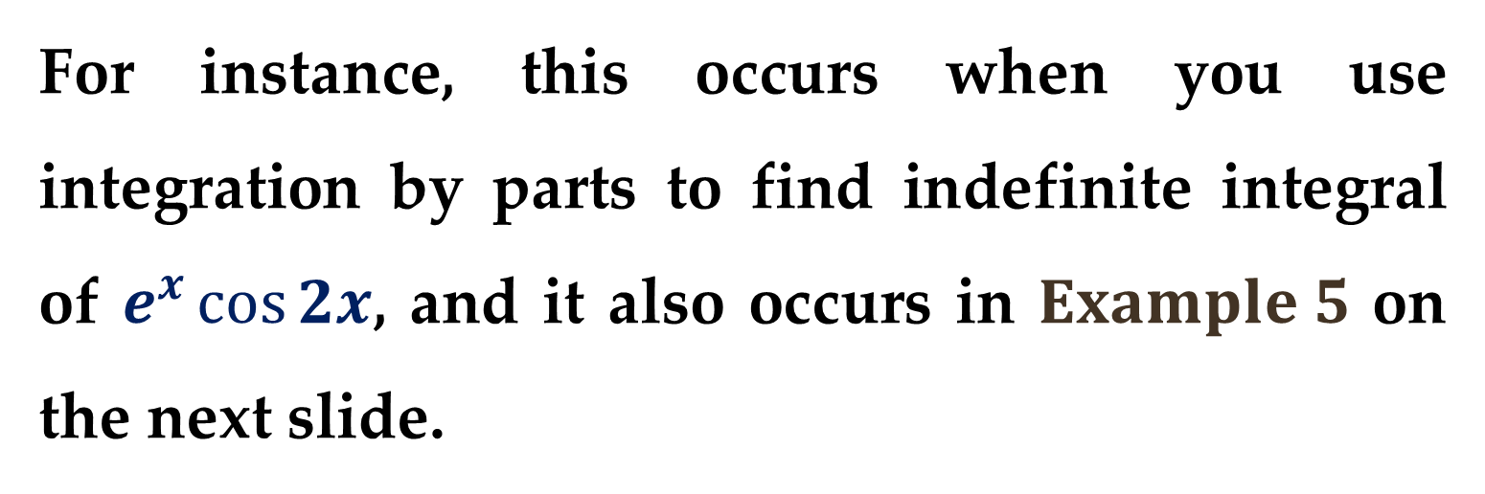
When making repeated applications of integration by parts, we should also watch for the appearance of a constant multiple of the original integral.
For instance, this occurs when you use integration by parts to find indefinite integral of $e^{x}\cos{2x}$, and it also occurs in $Example 5$ on the next slide.

Slide 23
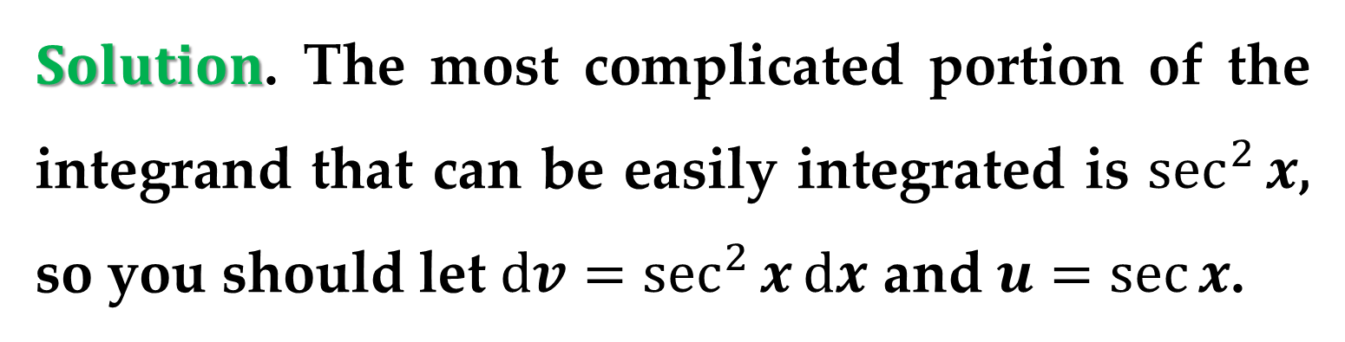
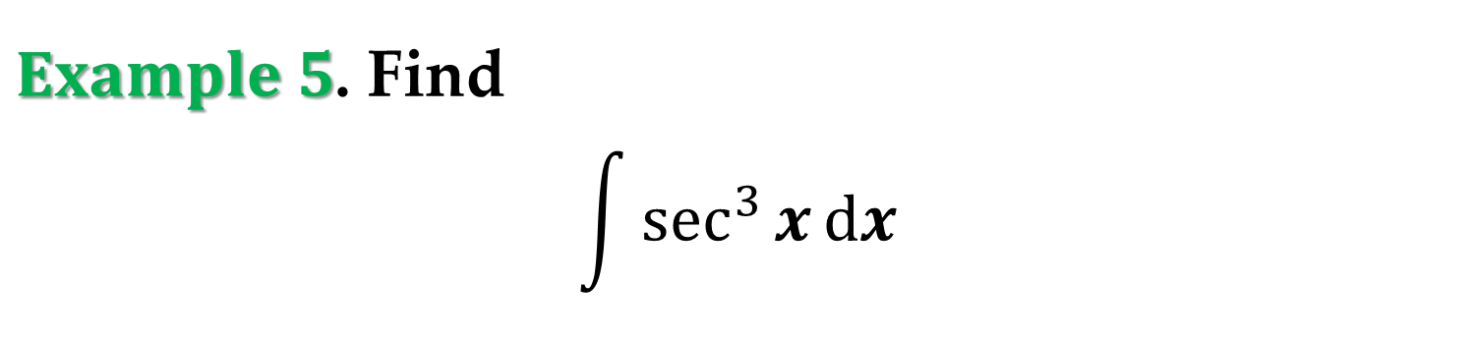
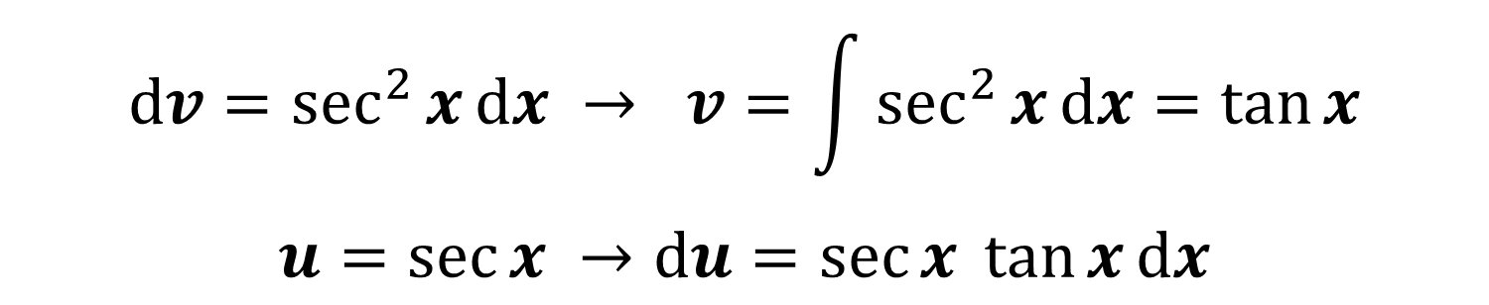
$Example 5$. Find
$$\int{\sec^{3}{x}dx}$$
$Solution$. The most complicated portion of the integrand that can be easily integrated is $\sec^{2}{x}$, so you should let $dv=\sec^{2}{x}dx$ and $u=\sec{x}$.
$$dv=\sec^{2}{x}dx → v=\int{\sec^{2}{x}dx}=\tan{x}$$
$$u=\sec{x} →du=\sec{x} \tan{x}dx$$

Slide 24
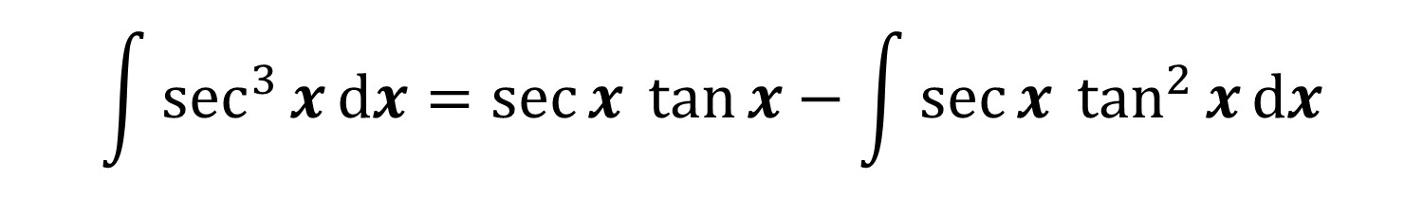
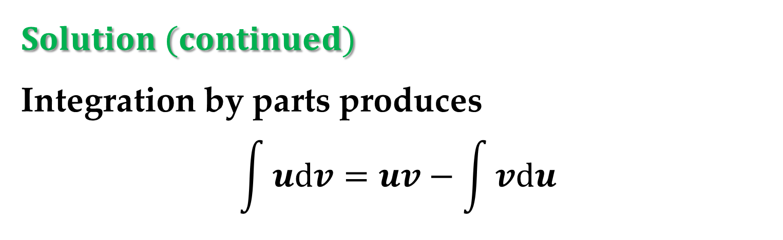
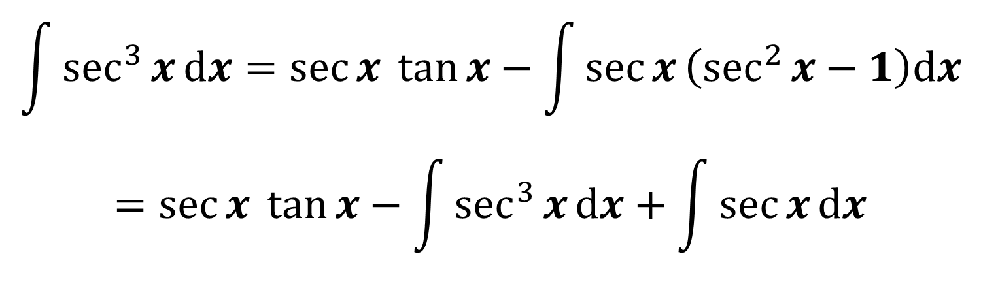
$$Solution (continued)$$
Integration by parts produces
$$\int{udv}=uv−\int{vdu}$$
$$\int{\sec^{3}{x}dx}=\sec{x} \tan{x}−\int{\sec{x} \tan^{2}{x}dx}$$
$$\int{\sec^{3}{x}dx}=\sec{x} \tan{x}−\int{\sec{x}\left(\sec^{2}{x}−1\right)dx}$$
$$=\sec{x} \tan{x}−\int{\sec^{3}{x}dx}+\int{\sec{x}dx}$$

Slide 25
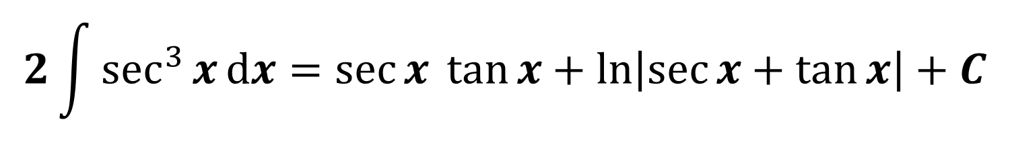
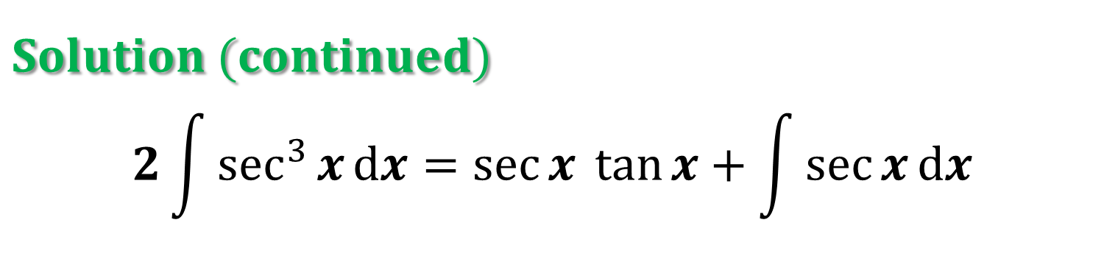
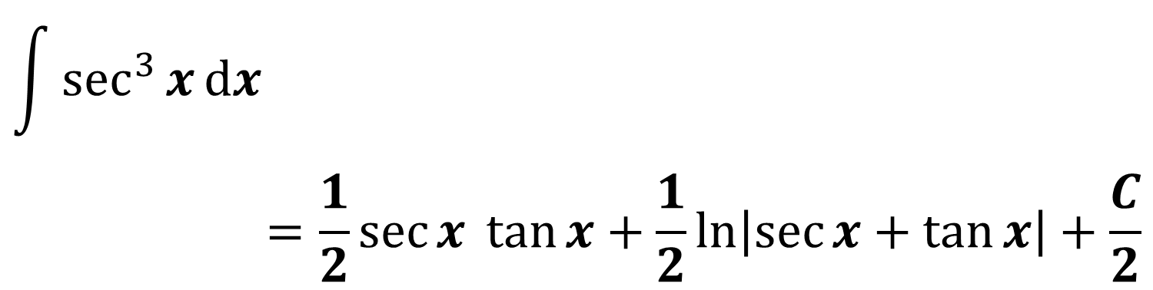
$$Solution (continued)$$
$$2\int{\sec^{3}{x}dx}=\sec{x} \tan{x}+\int{\sec{x}dx}$$
$$2\int{\sec^{3}{x}dx}=\sec{x} \tan{x}+\ln\left|\sec{x}+\tan{x}\right|+C$$
$$\int{\sec^{3}{x}dx}$$
$$=\frac{1}{2}\sec{x} \tan{x}+\frac{1}{2}\ln\left|\sec{x}+\tan{x}\right|+\frac{C}{2}$$

Slide 26
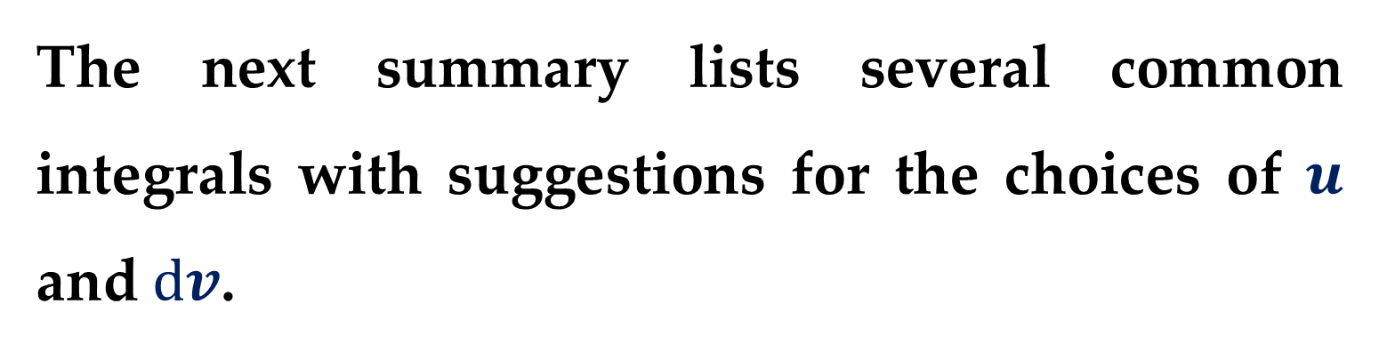
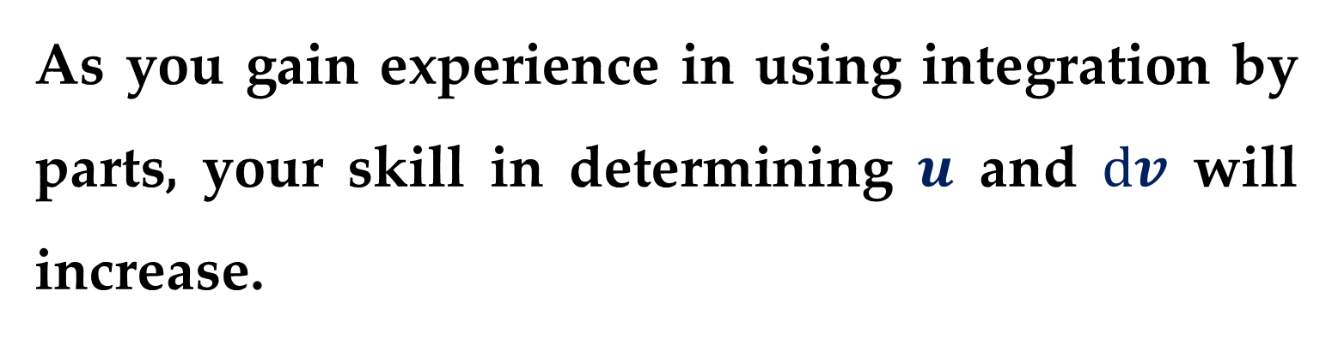
As you gain experience in using integration by parts, your skill in determining $u$ and $dv$ will increase.
The next summary lists several common integrals with suggestions for the choices of $u$ and $dv$.

Slide 27

$$Summary: Common Integrals Using$$
$$Integration by Parts$$
For integrals of the form
$$\int{x^{n}e^{ax}dx};\int{x^{n}\sin{ax}dx};\int{x^{n}\cos{ax}dx}$$
let $u=x^{n}$ and let $dv=e^{ax}dx$, $dv=\sin{ax}dx$, or $dv=\cos{ax}dx$.

Slide 28

$$Summary: Common Integrals Using$$
$$Integration by Parts$$
For integrals of the form
$$\int{x^{n}\ln{x}dx};\int{x^{n}\arcsin{ax}dx};\int{x^{n}\arctan{ax}dx}$$
let $u=\ln{x}$, $\arcsin{ax}$, or $\arctan{ax}$ and let $dv=x^{n}dx$.

Slide 29

$$Summary: Common Integrals Using$$
$$Integration by Parts$$
For integrals of the form
$$\int{e^{ax}\sin{bx}dx}; \int{e^{ax}\cos{bx}dx}$$
let $u=\sin{bx}$ or $u=\cos{bx}$ and let $dv=e^{ax}dx$.

Slide 30


In problems involving repeated applications of integration by parts, a tabular method, illustrated in $Example 6$, can help to organize the work.
This method works well for integrals of the form
$$\int{x^{n}e^{ax}dx};\int{x^{n}\sin{ax}dx};\int{x^{n}\cos{ax}dx}$$

Slide 31


$Example 6$.
Using the tabular method find
$$\int{x^{2}\sin{4x}dx}$$
$Solution$. Begin as usual by letting
$u=x^{2}$ and $dv=v^{′}dx=\sin{4x}dx$
Next, create a table consisting of three columns, as shown.

Slide 32

$$Solution (continued)$$
Alternate signs |  | $u$ and its derivatives |  | $v′$ and its antiderivatives
$$+$$ |  | $$x^{2}$$ |  | $$\sin{4x}$$
$$−$$ |  | $$2x$$ |  | $$−\frac{1}{4}\cos{4x}$$
$$+$$ |  | $$2$$ |  | $$−\frac{1}{16}\sin{4x}$$
$$−$$ |  | $$0$$ |  | $$\frac{1}{64}\cos{4x}$$
Differentiate until you obtain $0$ as a derivative.

Slide 33

$$Solution (continued)$$
The solution is obtained by adding the signed products of the diagonal entries:
$$\int{x^{2}\sin{4x}dx}=−\frac{1}{4}x^{2}\cos{4x}+\frac{1}{8}x\sin{4x}+$$
$$+\frac{1}{32}\cos{4x}+C$$

Slide 34
Thank you for attention

Slide 35
text
text
text

Slide 36

$$Solution (continued)$$
text
text
text

